Slide 1
Approximate expansions for wave and KdV equations via the velocity potential and non-local formulations
Sultan AITZHAN, Yale-NUS College
Supervisor: Prof. Katie Oliveras
Co-Supervisor: Prof. Dave Smith
Nov 6, 2019

Slide 2
Approximate expansions for wave and KdV equations via the velocity potential and non-local formulations
Sultan AITZHAN, Yale-NUS College
Supervisor: Prof. Katie Oliveras
Co-Supervisor: Prof. Dave Smith
Nov 6, 2019

Slide 3
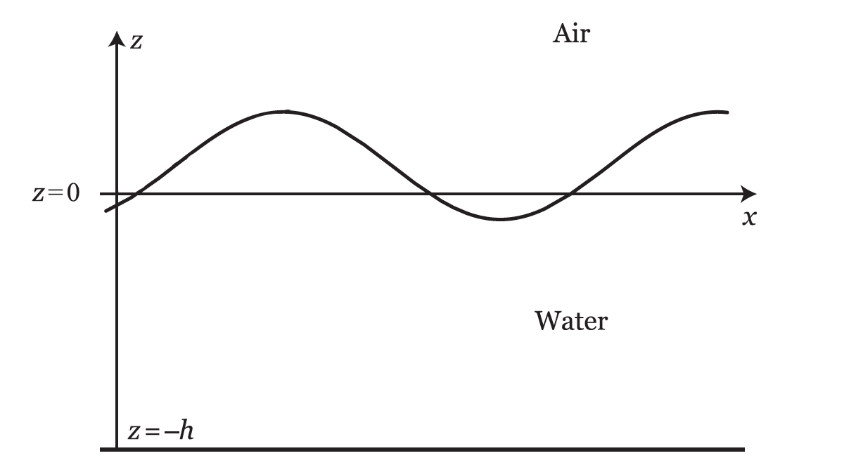
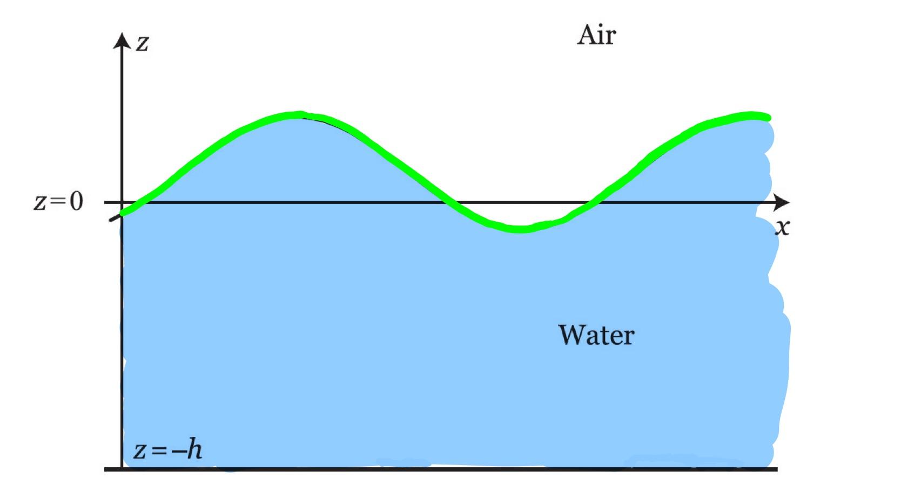
Consider the following problem:
Notes:
To motivate the project, suppose we wish to solve some PDEs.
Solving PDEs is hard. But if we are lucky, we can transform it into an ODE, which is easier to solve. After obtaining the solution to the ODE, we can then use the inverse transform to turn it into the solution to the PDE.
But most of the times we are not this lucky.

Slide 4
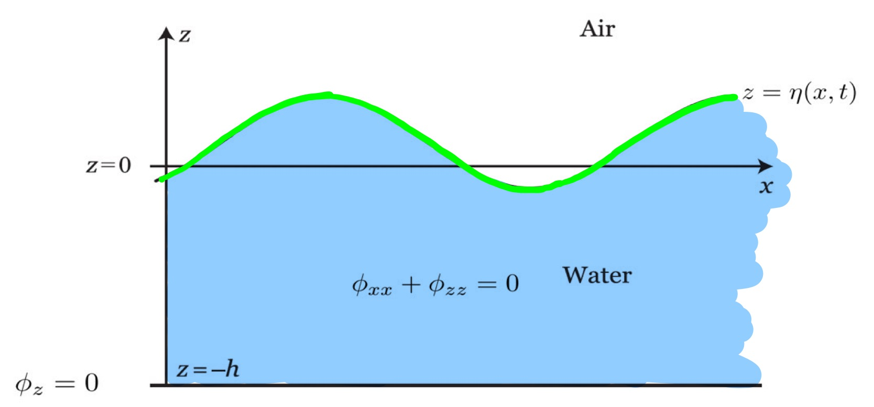
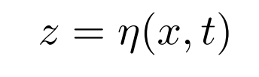


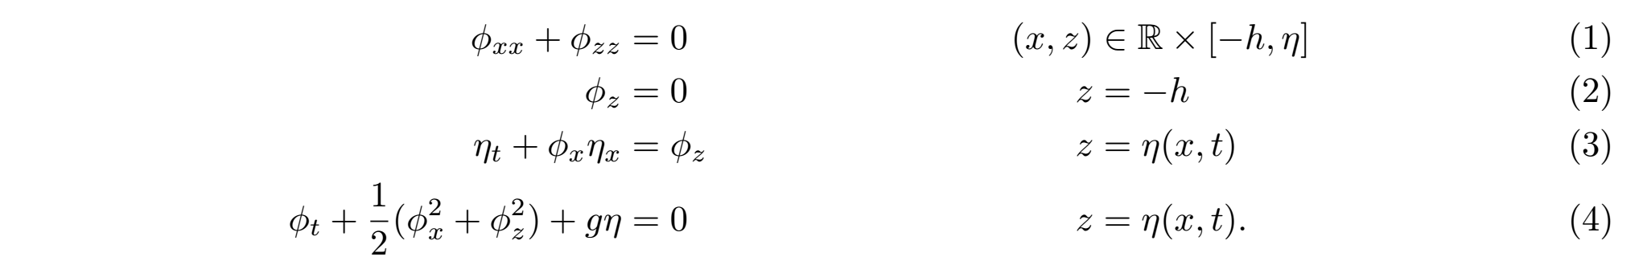
Consider the following problem:
Mathematically:
This is referred to as a water wave problem on the whole line.
Notes:
To motivate the project, suppose we wish to solve some PDEs.
Solving PDEs is hard. But if we are lucky, we can transform it into an ODE, which is easier to solve. After obtaining the solution to the ODE, we can then use the inverse transform to turn it into the solution to the PDE.
But most of the times we are not this lucky.

Slide 5
Approximate expansions for wave and KdV equations via the velocity potential and non-local formulations
Sultan AITZHAN, Yale-NUS College
Supervisor: Prof. Katie Oliveras
Co-Supervisor: Prof. Dave Smith
Nov 6, 2019

Slide 6
Consider the following problem:
Mathematically:
This is referred to as a water wave problem on the whole line.
Notes:
To motivate the project, suppose we wish to solve some PDEs.
Solving PDEs is hard. But if we are lucky, we can transform it into an ODE, which is easier to solve. After obtaining the solution to the ODE, we can then use the inverse transform to turn it into the solution to the PDE.
But most of the times we are not this lucky.

Slide 7
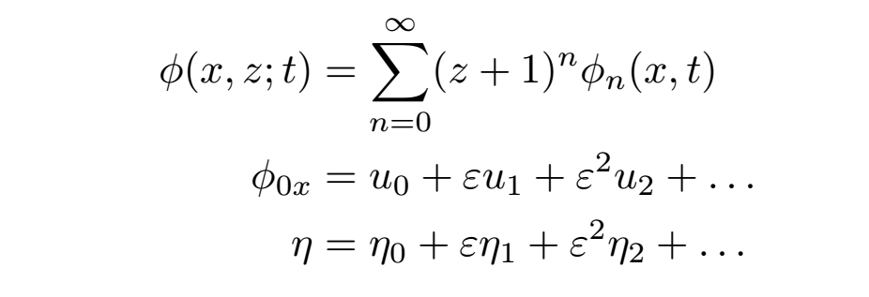
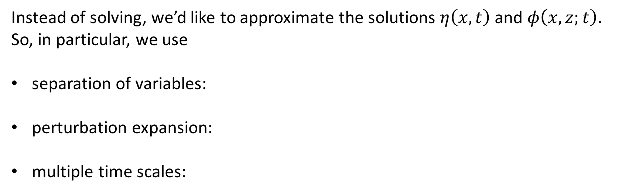
Observation: equations (3) and (4) are non-linear partial differential equations (PDEs):
Instead of solving, we’d like to approximate the solutions $η\left(x,t\right)$ and $φ\left(x,z;t\right)$.
So, in particular, we use
separation of variables:
perturbation expansion:
multiple time scales:
Notes:
To motivate the project, suppose we wish to solve some PDEs.
Solving PDEs is hard. But if we are lucky, we can transform it into an ODE, which is easier to solve. After obtaining the solution to the ODE, we can then use the inverse transform to turn it into the solution to the PDE.
But most of the times we are not this lucky.

Slide 8
Approximate expansions for wave and KdV equations via the velocity potential and non-local formulations
Sultan AITZHAN, Yale-NUS College
Supervisor: Prof. Katie Oliveras
Co-Supervisor: Prof. Dave Smith
Nov 6, 2019

Slide 9
Observation: equations (3) and (4) are non-linear partial differential equations (PDEs):
Instead of solving, we’d like to approximate the solutions $η\left(x,t\right)$ and $φ\left(x,z;t\right)$.
So, in particular, we use
separation of variables:
perturbation expansion:
multiple time scales:
Notes:
To motivate the project, suppose we wish to solve some PDEs.
Solving PDEs is hard. But if we are lucky, we can transform it into an ODE, which is easier to solve. After obtaining the solution to the ODE, we can then use the inverse transform to turn it into the solution to the PDE.
But most of the times we are not this lucky.

Slide 10
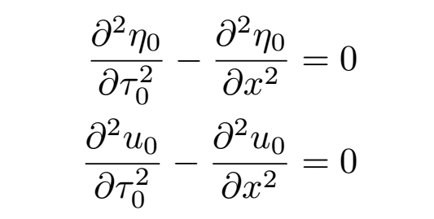
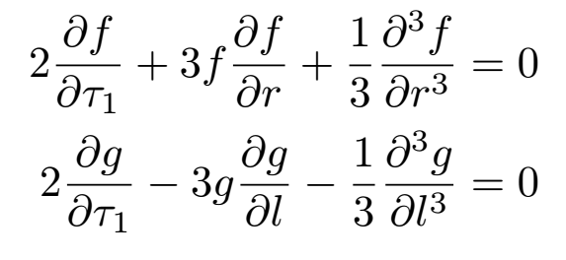
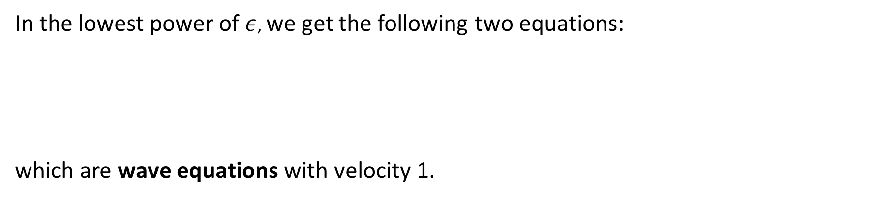
In the lowest power of $ε$, we get the following two equations:
which are wave equations with velocity 1.
In the next power of $ε$, we obtain two Korteweg de Vries (KdV) equations:
Notes:
To motivate the project, suppose we wish to solve some PDEs.
Solving PDEs is hard. But if we are lucky, we can transform it into an ODE, which is easier to solve. After obtaining the solution to the ODE, we can then use the inverse transform to turn it into the solution to the PDE.
But most of the times we are not this lucky.

Slide 11
Approximate expansions for wave and KdV equations via the velocity potential and non-local formulations
Sultan AITZHAN, Yale-NUS College
Supervisor: Prof. Katie Oliveras
Co-Supervisor: Prof. Dave Smith
Nov 6, 2019

Slide 12
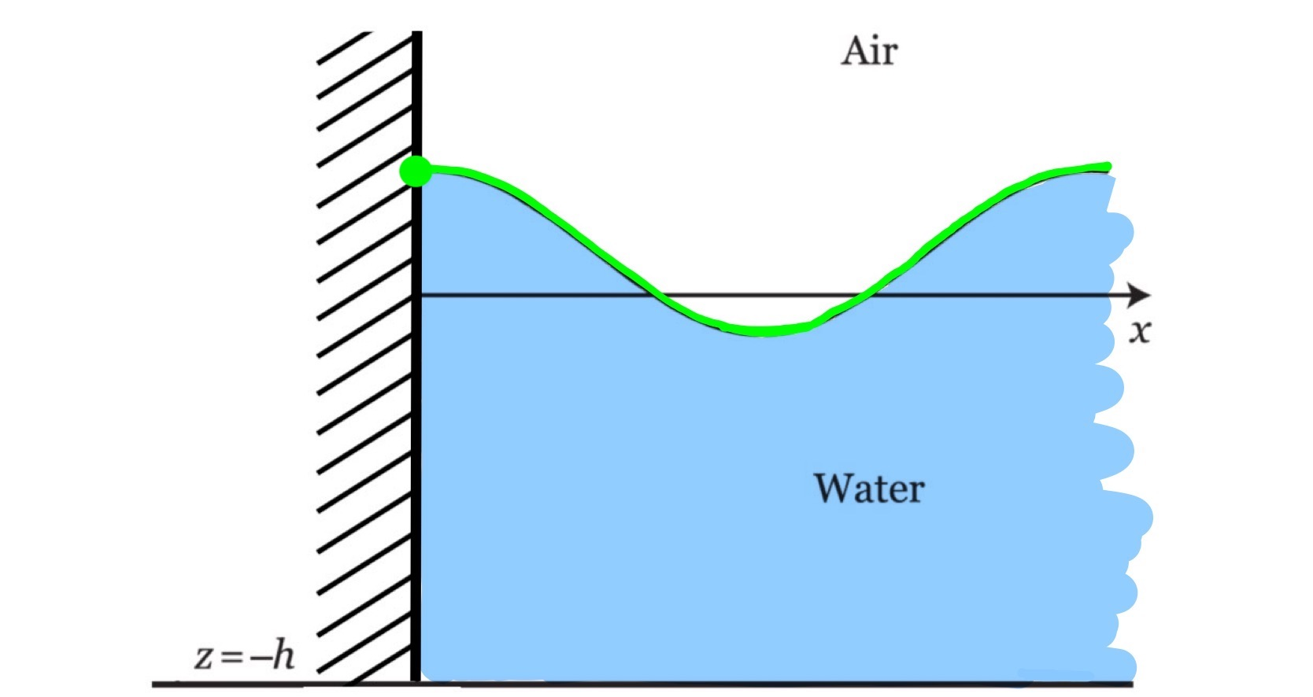

Notes:
Build an integrator tailored to this type of problems that can provide…
Solutions of PDEs usually involve infinite sums and integrals. Having accurate numerical descriptions for the solutions would be helpful in understanding and visualizing the solutions.

Slide 13
Capstone outline
Goal 1: Derive wave and KdV equations on a half-line in the velocity potential and provide the necessary conditions for this derivation.
Notes:
Build an integrator tailored to this type of problems that can provide…
Solutions of PDEs usually involve infinite sums and integrals. Having accurate numerical descriptions for the solutions would be helpful in understanding and visualizing the solutions.

Slide 14
Capstone outline
Goal 1: Derive wave and KdV equations on a half-line in the velocity potential and provide the necessary conditions for this derivation.
Goal 2: Derive wave and KdV equations on the whole and half-line in the non-local formulation.
Goal 3: Depending on results, examine their utility and potential applications, in the form of an exploration.
Notes:
Build an integrator tailored to this type of problems that can provide…
Solutions of PDEs usually involve infinite sums and integrals. Having accurate numerical descriptions for the solutions would be helpful in understanding and visualizing the solutions.

Slide 15
Summary
Nonlinear PDEs are hard to solve directly, so we approximate the problem.
Perturbation expansion and time scales analysis can be used to obtain wave and KdV equations on a whole line.
It is of interest to extend the procedure in (2) to the half-line problem, and derive these results in the integral formulation.

Slide 16
References
Ablowitz, M. J. (2011). Nonlinear dispersive waves: Asymptotic analysis and solitons. Cambridge: Cambridge University Press.
Deconinck, B. (2010). Nonlinear waves.
Oliveras, K. (2019). Detailed notes: a reduction of the Euler equations to a single time dependent equation.
Ablowitz, M. J., Fokas, A. S., & Musslimani, Z. H. (2006). On a new non-local formulation of water waves. Journal of Fluid Mechanics, 562, 313-343.

